Slide 1
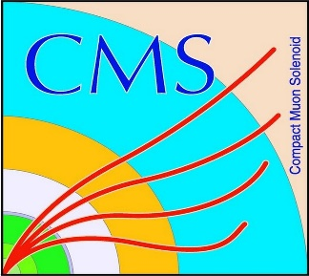

HEP Weekly Report
George Bakas
NTUA

Slide 2
Progress Report
DCS
CMSfwRack
Creating an expert panel: goal is to select several datapoint elements that have alarm configuration for a specific set of datapoint type Racks and activate them or deactivate them
There is an existing panel which lets the expert user activate or deactivate all datapoint element alarms of a specific dp Type
Also implementation of import/export csv files for doing so
Finished and waiting for deploy
CMSfwAdministration
checkOwners panel: this gives user the ability to change the ownership of the FSM cu’s-> bug found and fixed (was not working from remote UI)
Analysis
Spin Correlation
Validation plots of the spin correlation and non spin correlation sample
The request for the sample with no spin correlation will be submitted in the Fall18 campaign
Production with samples that have the mtt cut (1000-Inf)
Helping Giannis with Top Tagger efficiencies etc

Slide 3
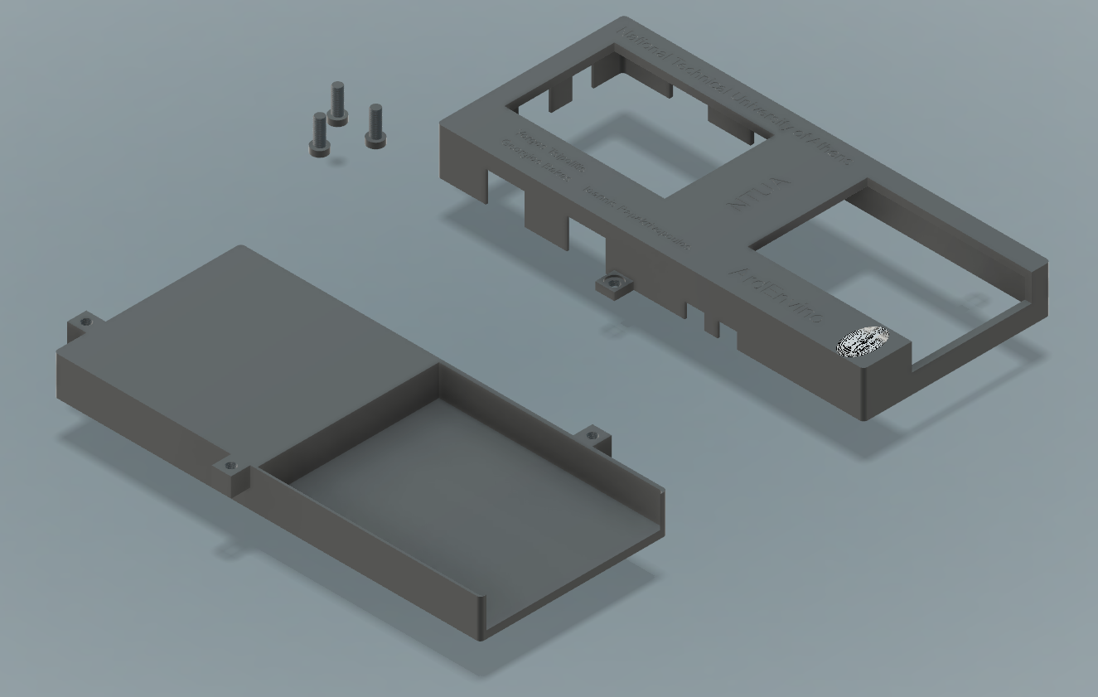
ArdEnvino
Finished designing box
Meeting with Florian on Monday for 3D print

